Slide 1

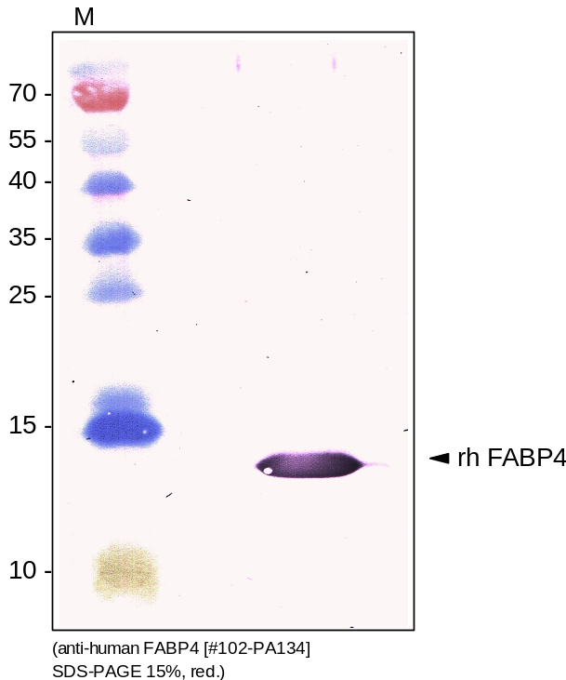
ReliaTechGmbH
Rabbit anti-human FABP4
(Cat #102-PA134S / -PA134)
Figure 1. Western analysis of recombinant human FABP4 [Cat# 400-018] using a rabbit polyclonal anti-human FABP4 antibody [Cat# 102-PA134]. [WB: AP-conjugated secondary antibody]
http://www.reliatech.de / orders@reliatech.de

